Slide 1
Lassi Shop
Vaishnavi S​

Slide 2
Abstract :
The Lassi Shop Angular Project aims to develop a dynamic and user-friendly web application for a lassi shop to enhance customer experience and optimize operational efficiency. It has User side and Admin side where admin can add product, delete ,edit and update, and user can Buy the Product, save the product into the card and review it and suggests what is required more.

Slide 3
implementation
Implement a SPA application with lazy loading with two user type flow are Admin flow and User flow
Maintain the data in Json and serve it through Json-server-auth,
Rest end points are secured, it should be accessible only when token passed
Also implement,
- Pipes,
- Form handling [with validation],
- Routing, Child Routing, Routing Parameters,
- HTTP Client and Observables
- and Use Angular Material.
Then, the images are stored in nginx.

Slide 4
Flow Chart
Login
Admin
User
1.Search
4. Cart
1.Search
2.Add
2.View
Delete Item
Delete all Item
3.Edit
3.Post Review
4.Delete
Logout

Slide 5
Default Login Page Appears

Slide 6
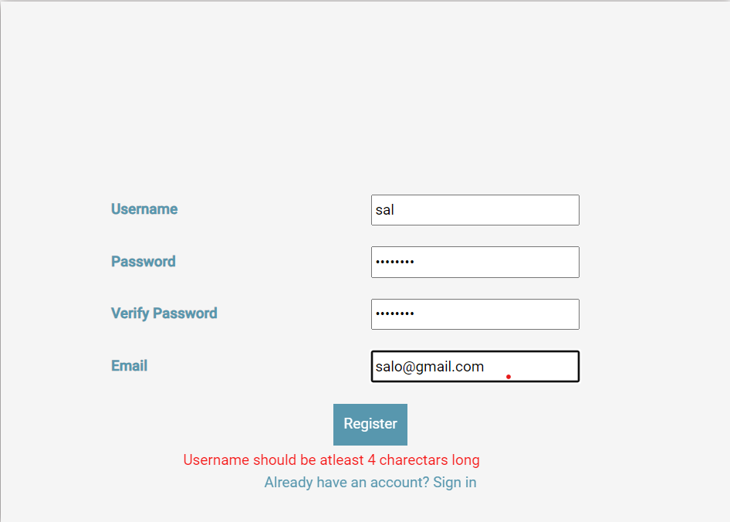
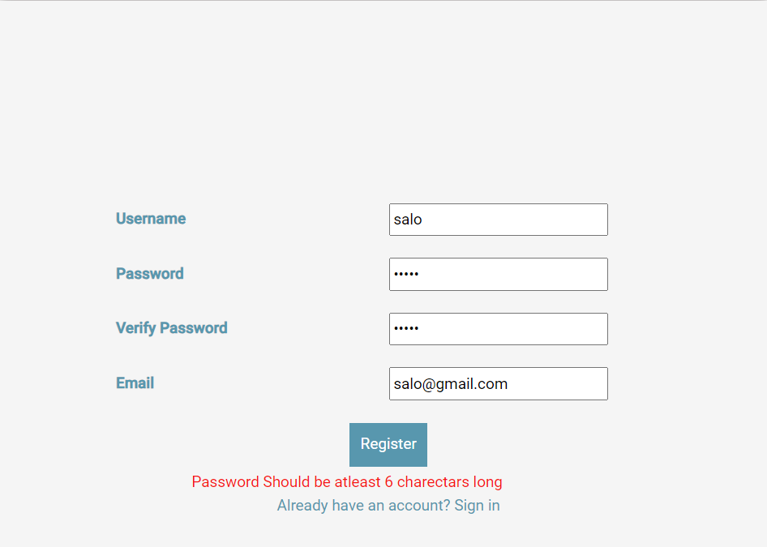
When invalid credentials are given ,it notifies the user
 |  |  | When Registering new user, validation are kept.

Slide 7
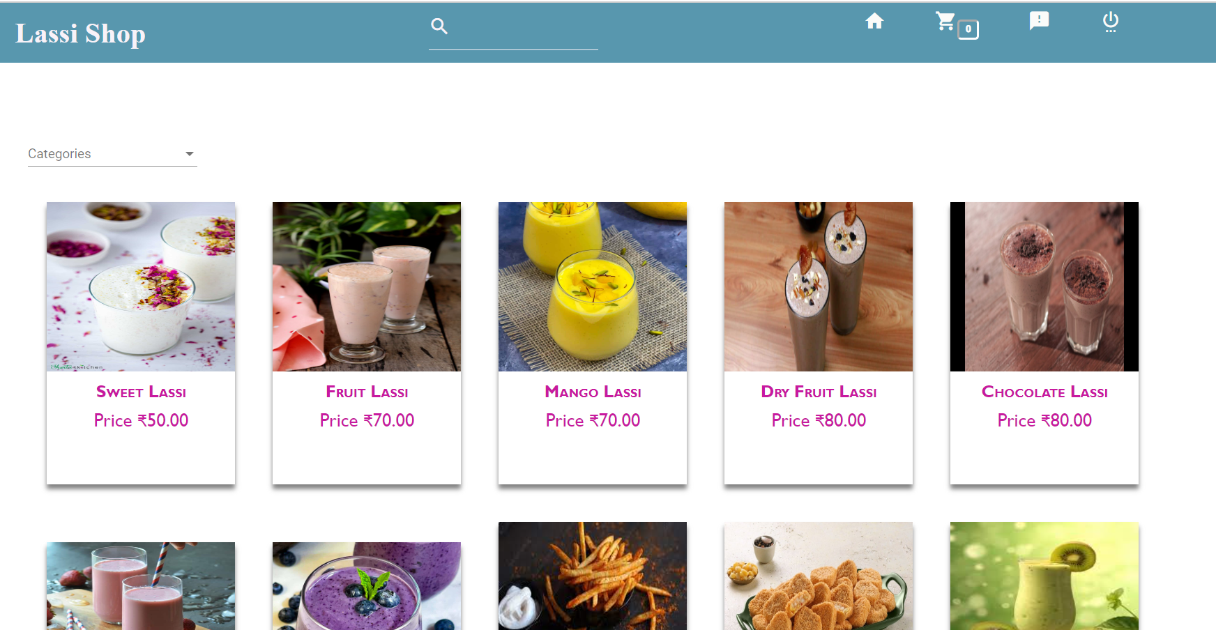
This is the user's home page.
The items will be displayed with the item name, image, and price details.
Here We can search By categories and search by item name in search bar[filtering method]
While clicking on the particular item, it will be redirected to another page.

Slide 8
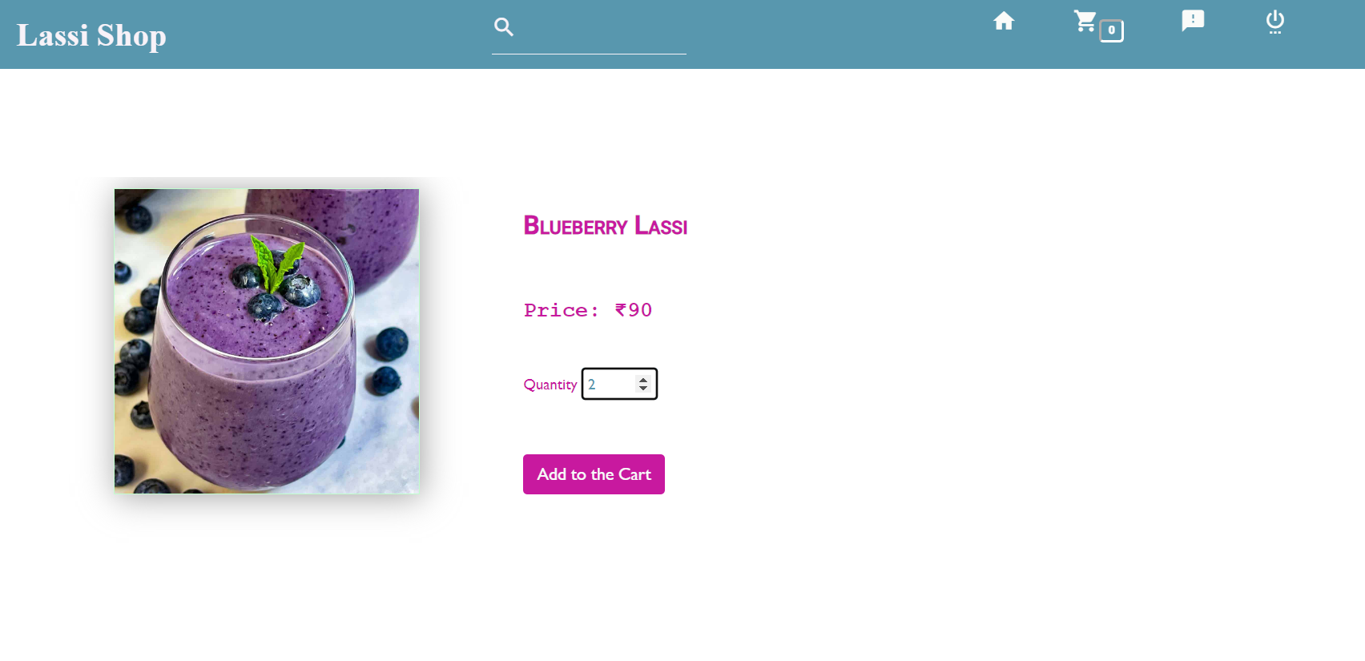

Slide 9
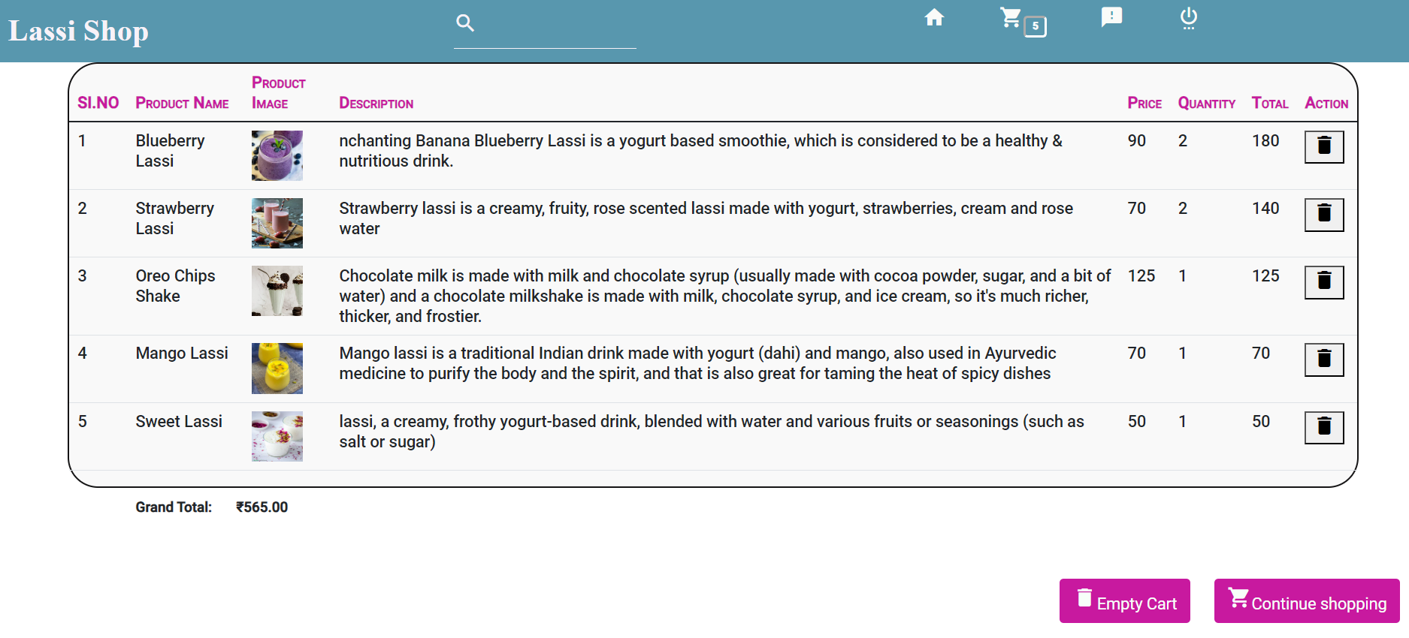

Slide 10
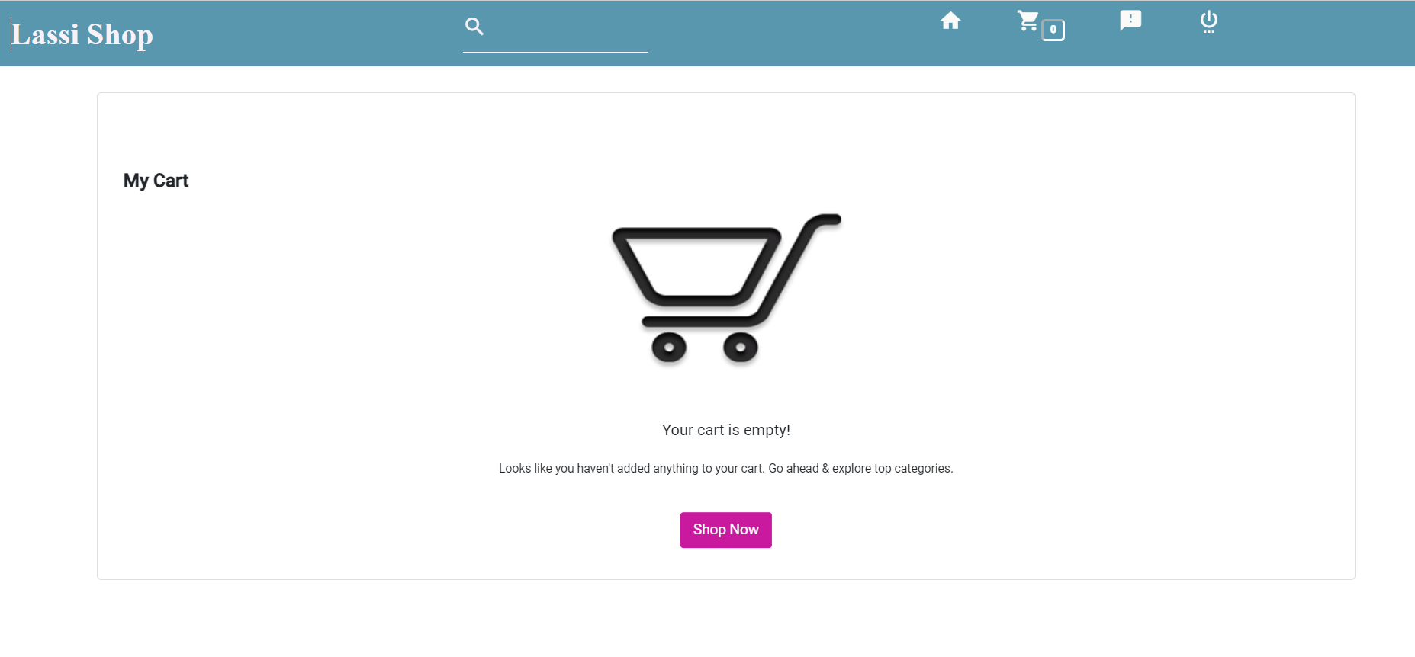

Slide 11
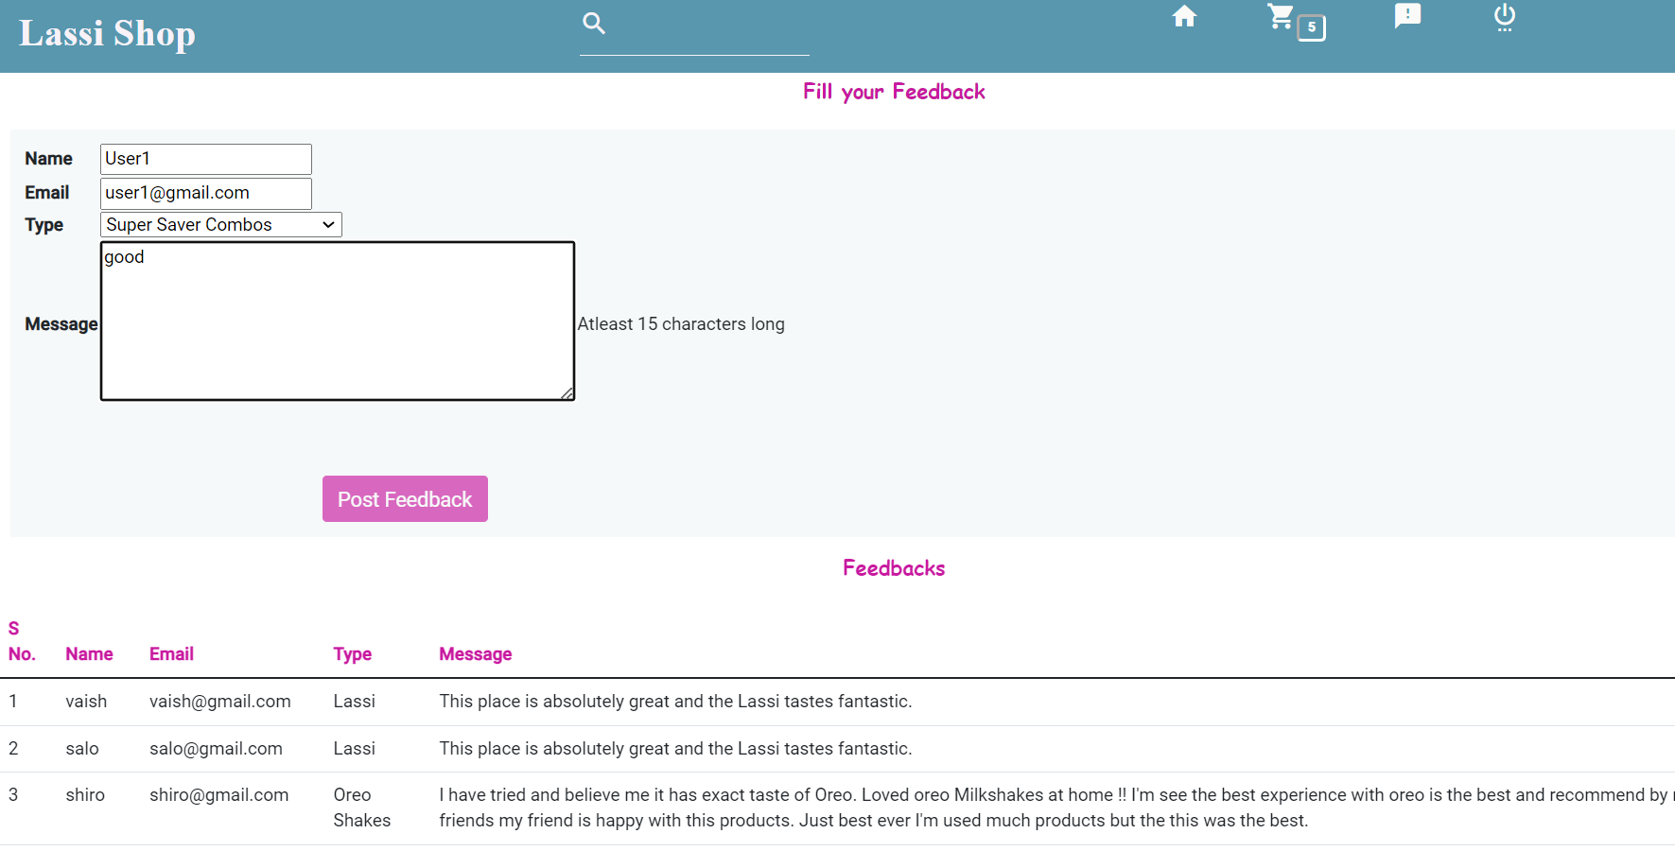

Slide 12
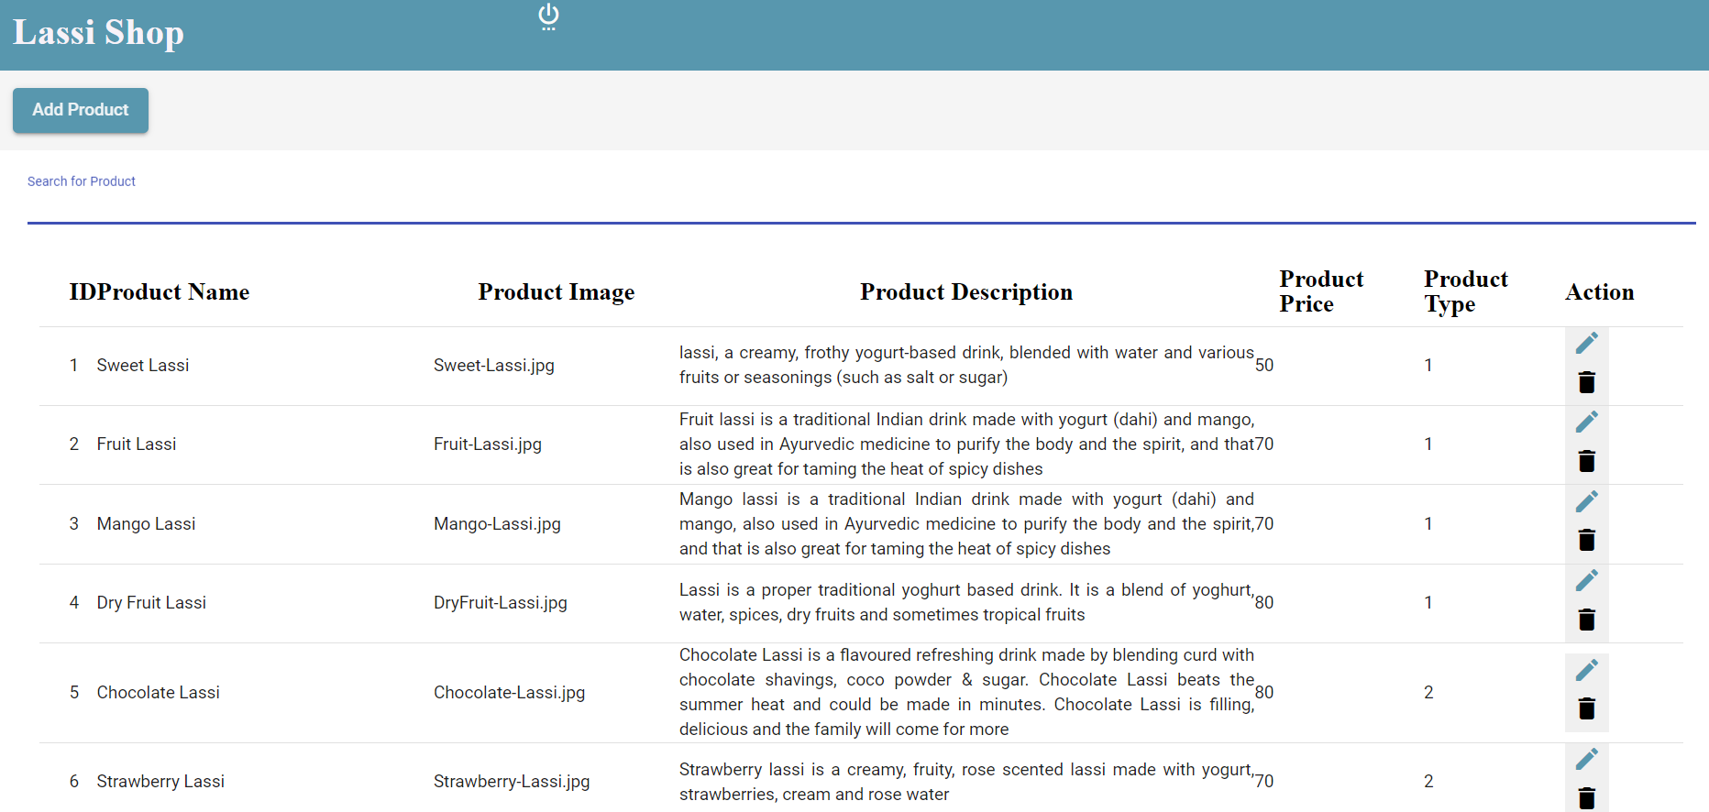

Slide 13
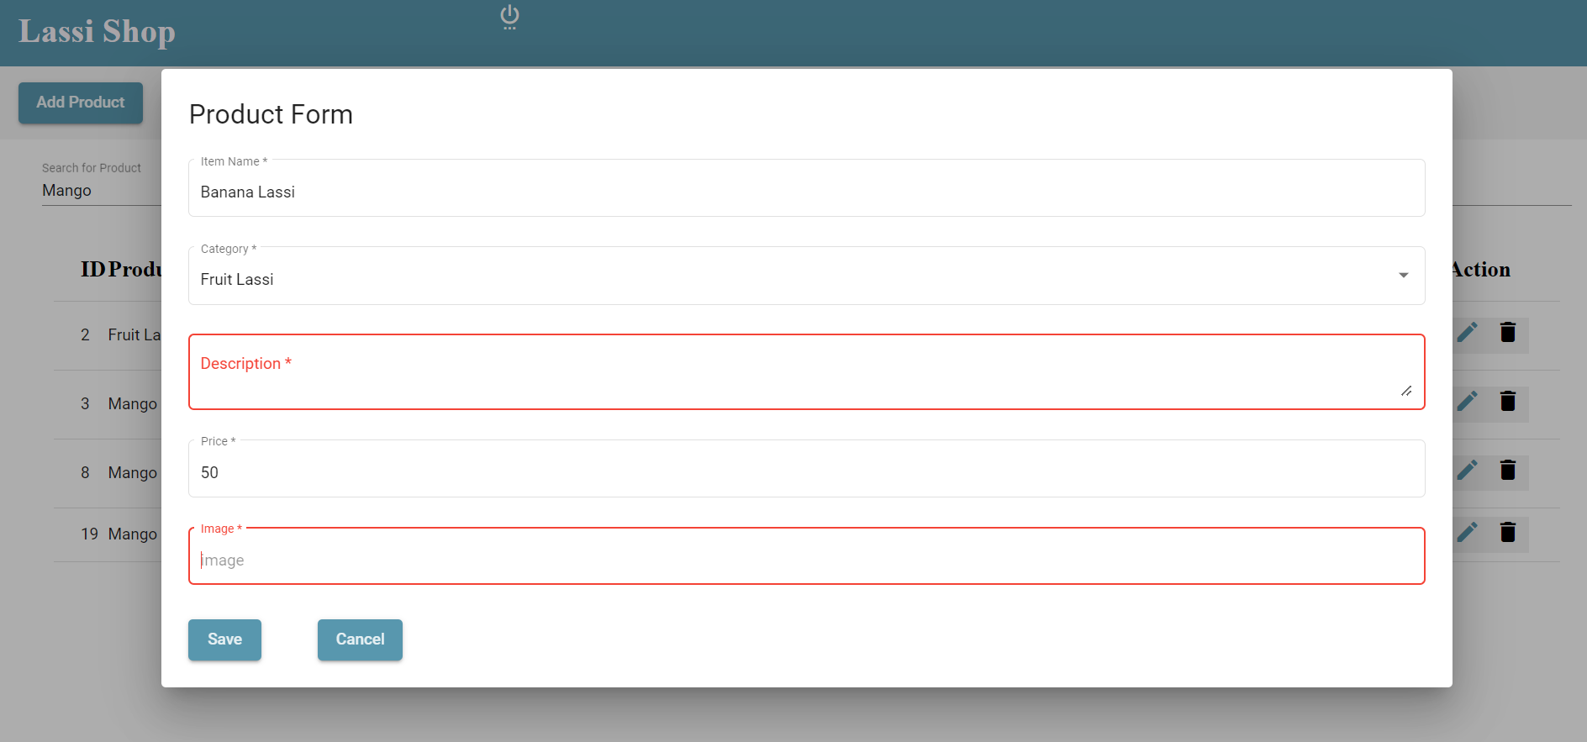

Slide 14
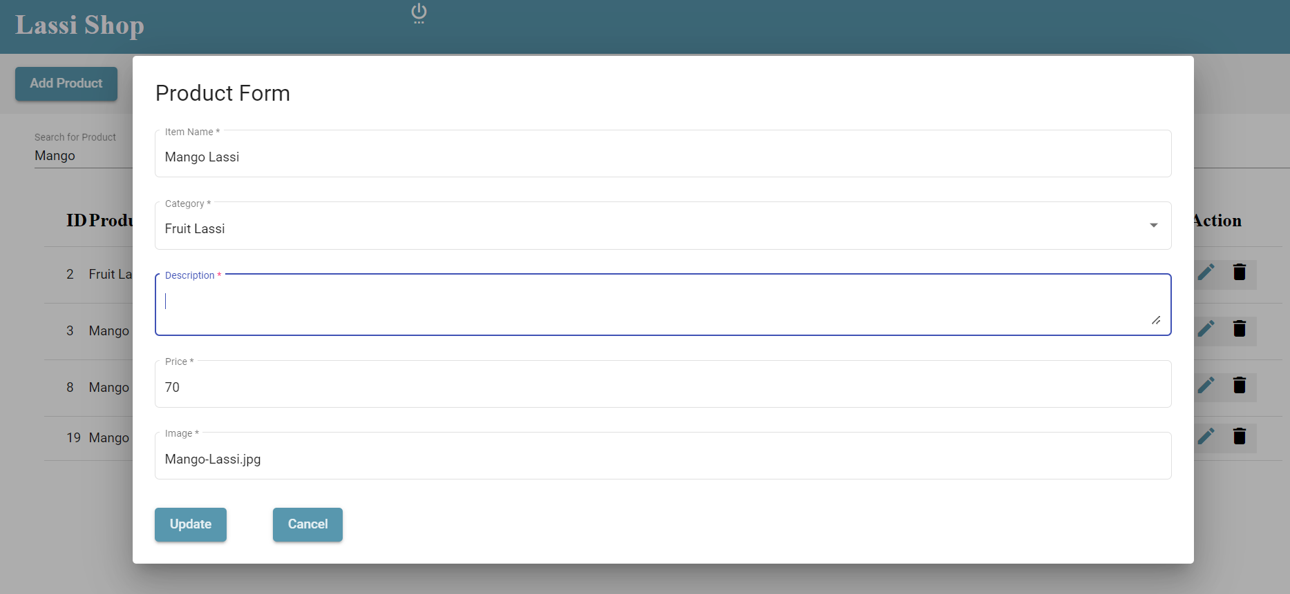

Slide 15
THANK YOU
~ By Vaishnavi S

